Slide 1
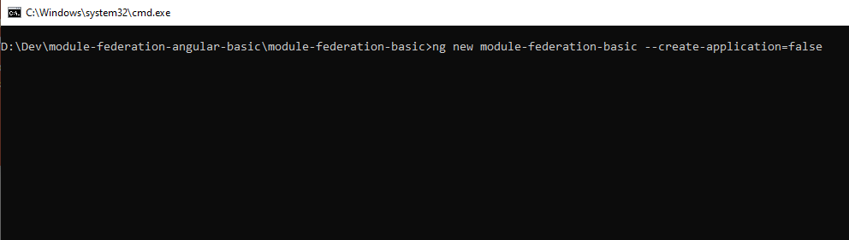
Create new angular workspace
ng new module-federation-basic --create-application=false

Slide 2
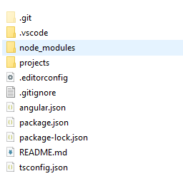
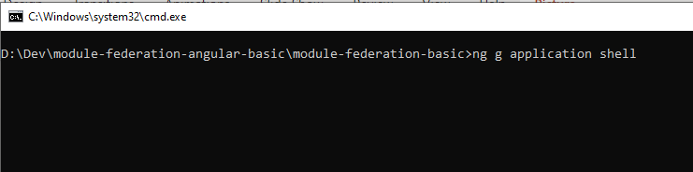
Create shell application
ng g application shell

Slide 3
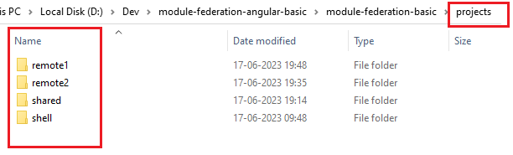
Create remote applications
ng g application remote1
ng g application remote2
Create a library application (optional)
ng g library shared

Slide 4
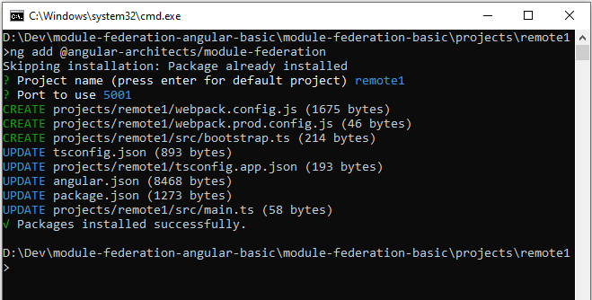
Add module-federation into project "remote1"
ng add @angular-architects/module-federation

Slide 5
Add module-federation into project "remote2" & "shell"
Move to project remote2 & shell perform the same action as last slide.

Slide 6
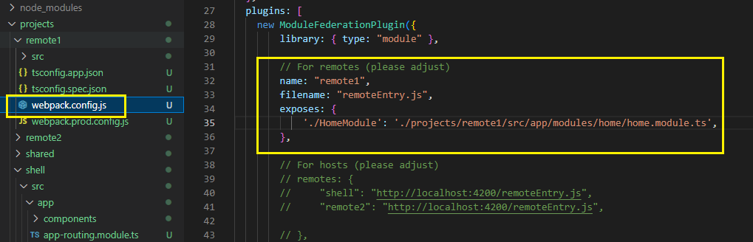
From "remote1" expose the AppModule
Open webpack.config.js
And add the module name and the path inside exposes object.
Do same for remote2.

Slide 7
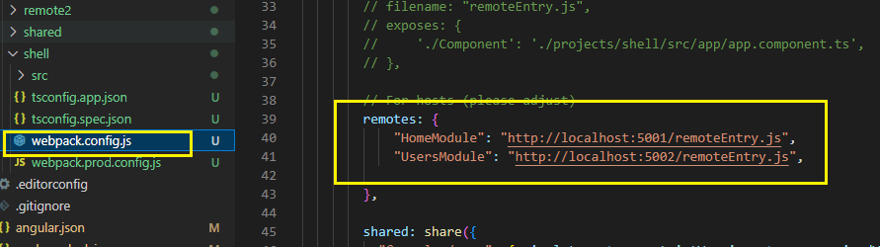
From "shell" define the remote paths
Open webpack.config.js
And add the paths for remote MFEs.

Slide 8
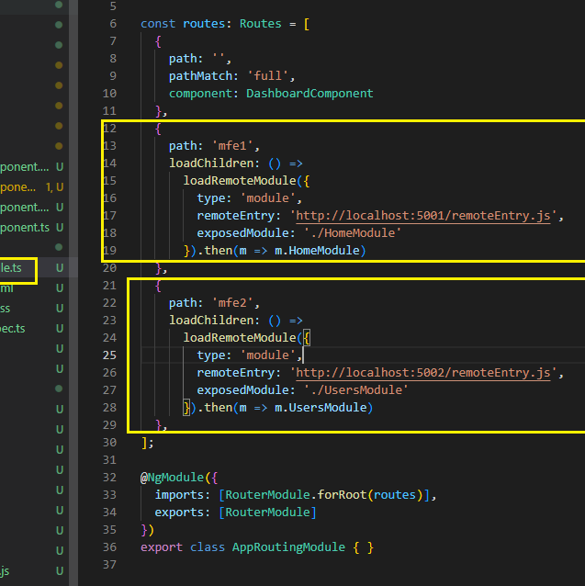
In "shell" configure routes to load modules
app-routing.module.ts
And add the paths

Slide 9
Versions mismatch
Static/classic module
Shell | Remote | Use version
^1.0.0 | ^1.0.1 | 1.0.1 |  | Takes highest compatible semantic version
~1.0.0 | 1.1.0 | Shell 1.0.0 | Remote 1.1.0 | Each app falls back to its own version (known as fallback module)

Slide 10
Versions mismatch
Dynamic module
Shell | Remote | Use version
^1.0.0 | ^1.0.1 | Shell 1.0.0 | Remote 1.0.1 | While loading the shell app, I has no clue about which version MFE uses so it fallbacks to its own version
^1.1.0 | ^1.0.1 | 1.1.0 |  | Micro frontend would decide to use the already loaded one.

Slide 11
Versions mismatch
Singleton
Shell | Remote | Use version
^1.1.0 | ^1.0.1 | 1.1.0 | Micro frontend would decide to use the already loaded one.
^2.0.0 | ^1.1.0 | 2.0.0 | In case of singleton Module Federation decides for only loading the highest available version(this may cause unforeseeable issues)

Slide 12
Versions mismatch
strictVersion
Shell | Remote | Use version
^2.0.0 | ^1.1.0 | X | While loading MFE it generates error: Unsatisfied version 2.0.0 required(1^.1.0)

Slide 13
Versions mismatch
requiredVersion
Shell | Remote | Use version
^2.0.0 | requiredVersion: ">=1.1.0 <3.0.0" | 2.0.0 | It falls undrer the range mentioned by MFE so takes the available version

